Slide 1
WellFit AI App
The Proposal

Slide 2






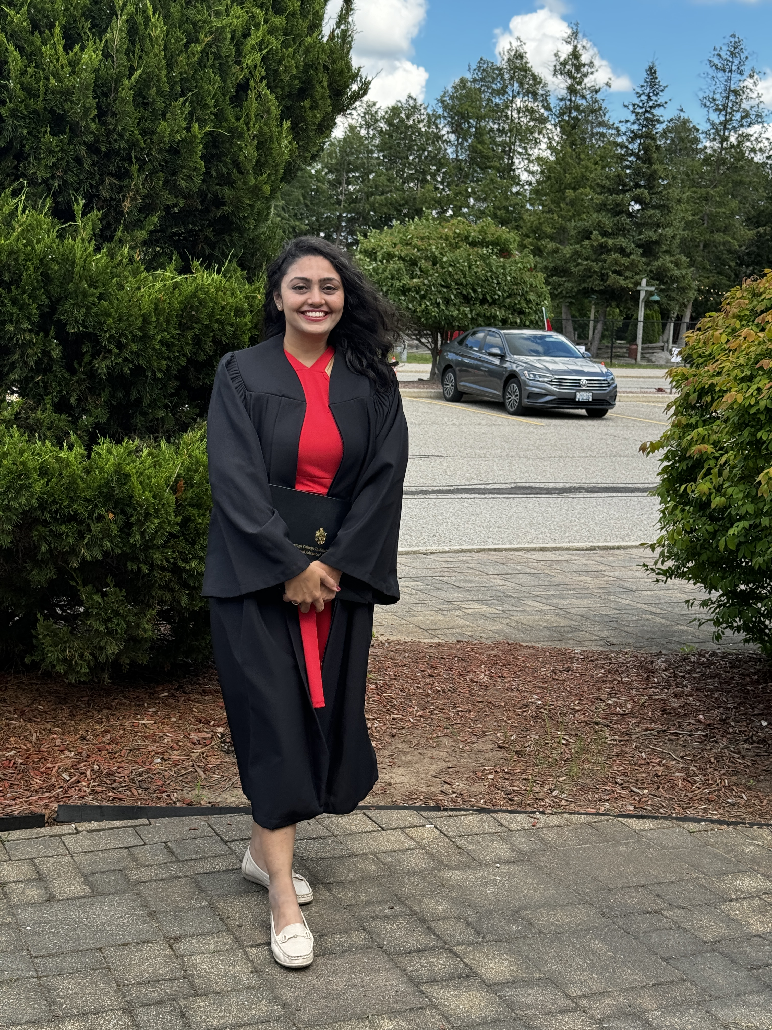
Team Introduction
Akshay Kapoor
Lead Business Analyst Strengths :
Analytical Thinking Experience : QA
Parbon Banerjee
Business Analyst Strengths:
Problem solving and documentation
Experience: B2B product executive
Muhammad Asad Bin Faruq
Project Manager Strengths: Documentation Experience:
Business Analyst
Nishita Ahuja
Marketing Analyst Strengths:
Data-Driven Decision Making
Experience:
Sales and Marketing Analyst
Musaab Shirgar
Data Analyst Strengths:
Proficient in data analysis tools
Experience:
Business Technology Analyst
Shilpa Sosa George
Quality Analyst
Strengths:
Analytical Thinking and attention to detail. Experience:
Software Tester(QA)
Labdhi Bharat Shah
Process Analyst
Strengths:
Identifying inefficiencies and process improvements
Experience: HR

Slide 3
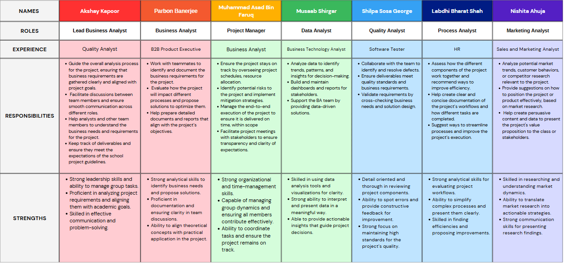
Team Structure

Slide 4

Solution Name: WellFit AI
WellFit AI is an AI-assisted fitness application designed for fitness enthusiasts, athletes, fitness and wellness centers, personal trainers, and beginners who aim to achieve their fitness goals without sacrificing time or convenience.
The application leverages AI-powered technology to observe body movements, such as counting push-up reps, monitoring calorie intake, and managing hydration levels. After analyzing water and calorie intake, WellFit AI provides a tailored set of exercises to suit individual fitness needs.
Each exercise comes with a short instructional video to guide users through proper techniques and ensure maximum effectiveness, making fitness accessible and personalized for everyone.

Slide 5
Problem Statement
The Problem Of | Managing fitness routines, tracking exercises, calorie intake, and hydration levels effectively.
Affects | Fitness enthusiasts of all levels, from beginners to experienced athletes.
The Impact Of Which Is | Inconsistent progress, lack of motivation, and difficulty in achieving fitness goals.
The successful solution would | Provide real-time feedback on exercise form using AI-powered motion tracking, monitors calorie intake and hydration, and suggests personalized fitness routines to help users achieve their goals with ease and precision.

Slide 6
Product Statement
For | Fitness enthusiasts of all levels.
Who | Want to effectively track their workouts, calorie intake, and hydration levels to achieve their fitness goals.
Product Name | WellFit AI
That | Tracks workouts using AI-powered movement recognition, monitors calorie intake and hydration, and provides personalized fitness routines.
Unlike | Other fitness apps on the market that provides only generic plans or track time.
Our Product | Is a comprehensive wellness platform that combines AI-powered training with personalized nutrition guidance for a complete approach to health and fitness.

Slide 7

Potential Users
Fitness and Wellness Centers
Fitness Enthusiasts
Athletes and Sports Professionals
Dietitians and Nutritionists

Slide 8

Value Proposition
What it Does
WellFit AI uses AI-powered technology to track your body movements during workouts, counting reps and providing real-time feedback. It also monitors calorie intake, tracks hydration levels, and generates personalized fitness plans to help you meet your health and wellness goals.
Why Potential Customers Want to Use It :
Helps users achieve their fitness and wellness goals more efficiently by providing tailored workouts that are optimized for their individual needs. It combines the benefits of a personal trainer, nutritionist, and fitness tracker into one powerful app.
WellFit AI is your all-in-one wellness platform.

Slide 9
Main Features
AI Recommendations: Suggests modifications or new exercises based on user performance and preferences
AI-Powered Movement Tracking: Tracks body movements to count reps accurately for exercises like push-ups and squats and count calories.
Calorie and Hydration Monitoring: Logs and monitors daily calorie consumption and water intake to optimize fitness plans.
Progress Insights and Analytics: Visual progress tracking, including workout summaries and achievements.
Goal Setting and Reminders: Helps users set fitness goals and sends reminders for workouts, hydration, and meals.
Personalized Fitness Plans: Tailored exercise routines based on individual fitness goals, calorie intake, and hydration levels.
Short Instructional Videos: Provide clear, concise video tutorials for each exercise to ensure proper form and technique.
Sleep Tracking: Tracks sleep quality and duration to optimize recovery and adjust workout recommendations.
Customizable Support: Customizable for individuals, fitness centers, personal trainers, and athletes.

Slide 10


Solution Comparison Analysis
Features | WellFit AI | Goodlife fitness | FitBit
AI Recommendations
AI-Powered Movement Tracking
Calorie and Hydration Monitoring
Progress Insights and Analytics
Goal Setting and Reminders
Personalized Fitness Plans
Book Gym Classes
Short Instructional Videos
Sleep Tracking
Wellness report

Slide 11
Thank You

